Slide 1

BUDGET CONTROLLING SYSTEM
MINI PROJECT FINAL REVIEW SEMINAR
By
K.KAUSHIK (10R11A0527)
N.CHARAN DAS (10R11A0539)
V.PRASHANTH(10R11A0556)
Under the guidance of
A.BIXAPATHI
(Assistant professor)
Department of Computer Science and Engineering
GEETHANJALI COLLEGE OF ENGINEERING & TECHNOLOGY
(Affiliated to JNTUH-HYD)
Cheeryal(V), Keesara(M), R.R. Dist. Hyderabad-501301, A.P.
Year : 20013-2014

Slide 2
BUDGET CONTROLLING SYSTEM
This project is aimed at developing a system by which the employees in the organization submit the bills to their managers.
The bills could be of various types and also of various amounts.
The employee after submitting the bill will automatically provide the manager’s name to which the bill will be submitted.
The bill will pass through a workflow process and the owner of the bill can view the status of the bill at any time.
An action on bills will be stored in to the concerned table, let them know about the status of the bill.
Development of this system is to provide fast and accurate results to the employees.

Slide 3
FEATURES OF THIS SYSTEM
A budgetary controlling system is a method of monitoring and controlling income and expenditure, for managing the demands for cash and minimizing borrowings.
It can be applied in a business context or by an individual in relation to his or her personal finances.
In a business environment it is most valuable as a tool to control the flow of cash.
Additionally, such a system would also ensure that cash will always be available for essential business purposes like buying raw materials.

Slide 4
MODULES
MODULE 1: ADMINISTRATOR
MODULE 2: MANAGER
MODULE 3: EMPLOYEE

Slide 5
MODULAR EXPLANATION
ADMINISTRATOR:
Admin can login with his User-id and Password.
He can create a new employee.
Admin can create new Expense and submit it to the manager. He can view all actions taken by the Finance manager on Expenses.
He can view his reports.

Slide 6
MANAGER:
Manager has a separate User-id and Password with which he can maintain his transactions.
Manager will decide the annual budget amount which will be displayed on Home Page of Employee and Admin.
Manager will take the decision on all types of expenses whether to Approve, Hold or Reject.
Manager also views reports.
EMPLOYEE:
Employee also has a separate username with which he can maintain his transactions.
Employee can enter an expense and submit to the manager.
Employee can view the reports to know the actions taken by the manager on expenses.

Slide 7
HARDWARE REQUIREMENTS
Processor : Intel Processor IV
RAM : 128 MB
Hard disk : 20 GB
CD drive : 40 x Samsung
Floppy drive : 1.44 MB
Monitor : 15’ Samtron color
Keyboard : 108 mercury keyboard
Mouse : Logitech mouse

Slide 8
SOFTWARE REQUIREMENTS
Operating System : Windows XP/2003 or Linux
User Interface : HTML, CSS
Client-side Scripting : JavaScript
Programming Language : Java
Web Applications : JDBC, Servlets, JSP
Database : My-Sql
Server Deployment : Tomcat 5.0

Slide 9
EXISTING AND PROPOSED SYSTEMS
EXISTING SYSTEM
Companies currently maintain all Account Transactions and Budget Information manually.
To overcome the limitations of manual system, computerized Account and Budget Control System has been introduced, which will solve the problems of the existing system.

Slide 10
PROPOSED SYSTEM
The information of the allocated budget amount and the expenses made by the company on budgeted account will be readily available.
This feature will allow Company to monitor the expenses of its branches under different budget/account head.
One of the strongest benefits of this Budget Controlling System over current manual system is the generation of most up-to-date trial balance at any time.
The generation of trial balance in current system takes considerable time and effort.
This application can be used by the server from any media like computer , mobile , touch pad etc. User can get the report in different chart formats like pie chart, bar chart etc...user can set the alert facility if the expenditure is meeting his stop value.

Slide 11
JAVA TOOLS

Slide 12
JDBC
This technology is an API for the Java programming language that defines how a client may access a database.
It provides methods for querying and updating data in a database.
JDBC is oriented towards relational databases.
A JDBC-to-ODBC bridge enables connections to any ODBC-accessible data source in the JVM host environment.

Slide 13
JSP
JavaServer Pages (JSP) is a technology that helps software developers create dynamically generated web pages based on HTML, XML, or other document types.
To deploy and run JavaServer Pages, a compatible web server with a servlet container, such as Apache Tomcat or Jetty, is required.

Slide 14
ENTITY-RELATIONSHIP DIAGRAM

Slide 15
ENTITY-RELATIONSHIP DIAGRAM
It is a graphical representation of entities and their relationships to each other, typically used in computing in regard to the organization of data within databases or information systems.
An entity is a piece of data, an object or concept about which data is stored.
A relationship describes how the data is shared between entities. There are three types of relationships:
One-to-one
One-to-many
Many-to-many

Slide 16
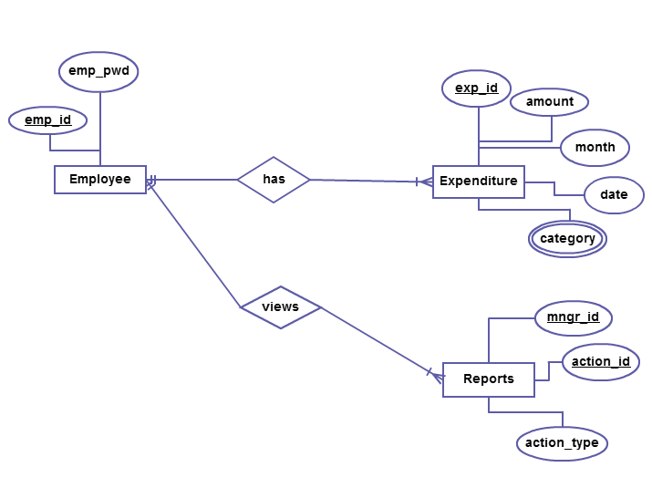
EMPLOYEE

Slide 17
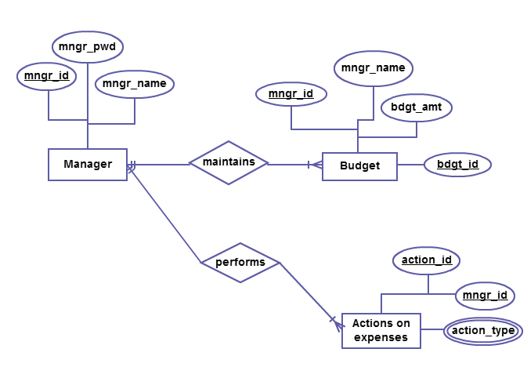
MANAGER

Slide 18
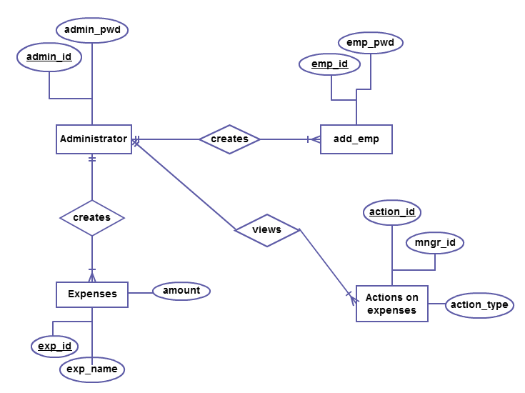
ADMINISTRATOR

Slide 19
UML DIAGRAMS

Slide 20
USE CASE DIAGRAM
A Use Case Model describes the proposed functionality of a new system. Use Case represents a discrete unit of interaction between a user (human or machine) and the system.
A Use Case description generally includes requirements, constraints, scenarios, general comments, notes and some additional attributes.

Slide 21
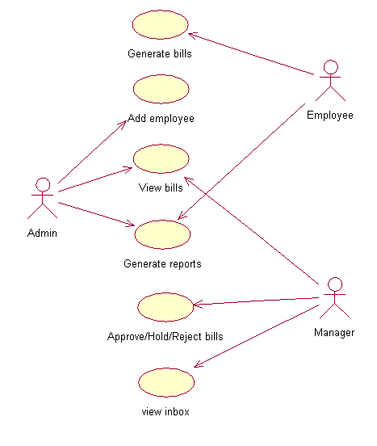

Slide 22
SEQUENCE DIAGRAM
Sequence diagrams provide a graphical representation of object interactions over time. These typically show a user or actor, and the objects and components they interact with in the execution of a use case.
The sequence diagram clearly shows the various actions that the modules perform in the application.

Slide 23
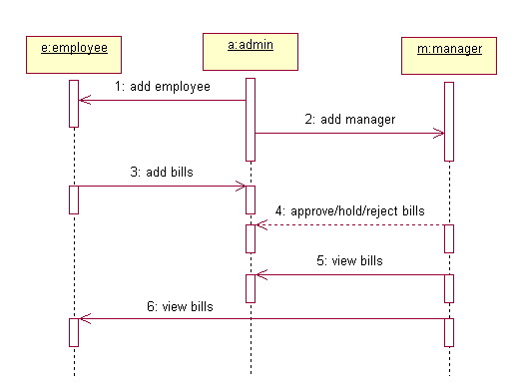

Slide 24
CLASS DIAGRAM
The class diagram is a static diagram. It represents the static view of an application.
The class diagram describes the attributes and operations of a class and also the constraints imposed on the system.
The class diagram shows a collection of classes, interfaces, associations, collaborations and constraints. It is also known as a structural diagram.
The purpose of the class diagram is to:
Analyze and design the static view of an application.
Describe responsibilities of a system.
Provide base for component and deployment diagrams.
Forward and reverse engineering.

Slide 25
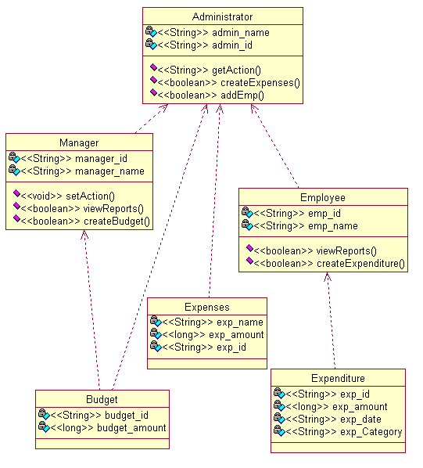

Slide 26
Activity diagram
Activity diagram is basically a flow chart that represents the flow form one activity to another activity. The activity can be described as an operation of the system.
This flow can be sequential, branched or concurrent. Activity diagrams deal with all type of flow control by using different elements like fork, join etc.
It captures the dynamic behavior of the system.
It does not show any message flow from one activity to another.

Slide 27
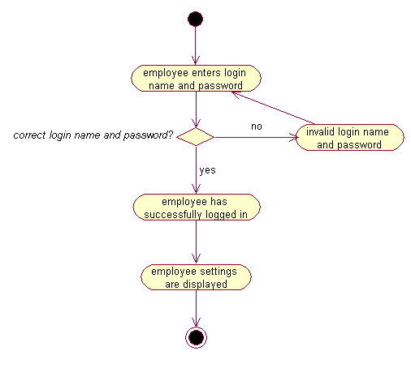

Slide 28
Deployment diagram
A deployment diagram in the Unified Modeling Language models the physical deployment of artifacts on nodes.
The nodes appear as boxes, and the artifacts allocated to each node appear as rectangles within the boxes.
Nodes may have sub nodes, which appear as nested boxes.

Slide 29
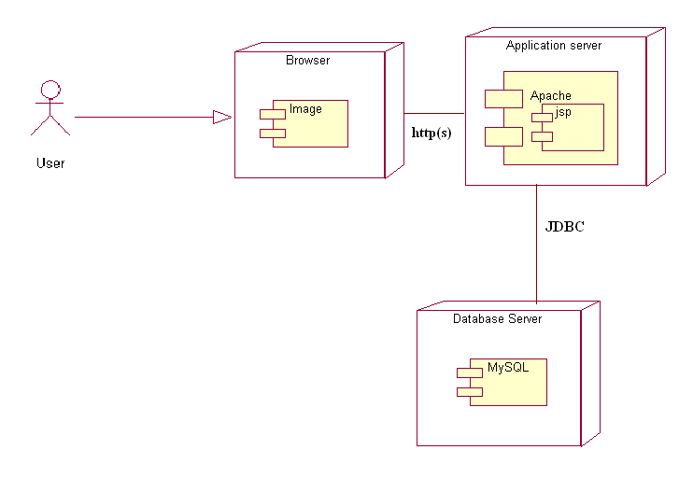

Slide 30
DATA FLOW DIAGRAMS

Slide 31
DATA FLOW DIAGRAMS
A data flow diagram (DFD) is a graphical representation of the "flow" of data through an information system, modeling its process aspects.
A DFD shows what kinds of information will be input to and output from the system, where the data will come from and go to, and where the data will be stored.

Slide 32
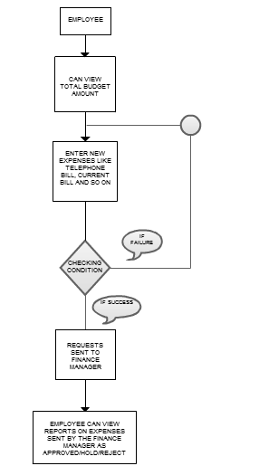
DFD:EMPLOYEE

Slide 33
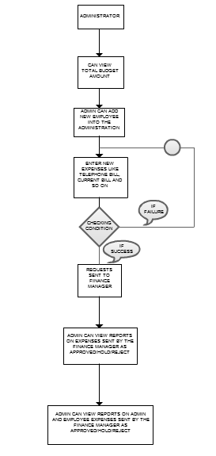
DFD:ADMINISTRATOR

Slide 34
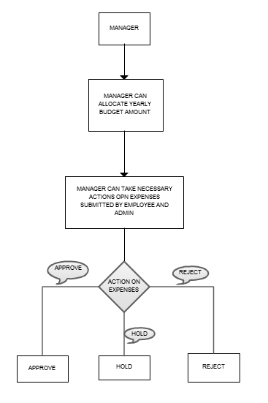
DFD:MANAGER

Slide 35
TESTING METHODS

Slide 36
SOFTWARE TESTING:- The software testing process commences once the program is created and the documentation and related data structures are designed. Software testing is essential for correcting errors. Otherwise the program or the project is not said to be complete.
Testing types: The following are the types of testing:
Unit Testing.
Integration Testing.
Validation Testing.
System Testing.
UNIT TESTING:- Unit testing focuses verification effort on the smallest unit of software design (i.e.), the module. Unit Testing exercise specific paths in a module’s control structure to ensure complete coverage and maximum error detection. This test focuses on each module individually, ensure that it functions properly as a unit. Hence, the name is unit testing.

Slide 37
INTEGRATION TESTING:- Integration Testing addresses the issues associated with the dual problems of verification and program construction. After the software has been integrated a set of High-order tests are conducted. The main objectives in this testing process is to take unit-tested modules and build a program structure that has been dictated by design. Top-down integration and bottom-up integration are the two different types of integration testing.
VALIDATION TESTING:- At the end of Integration Testing ,software is completely assembled as a package, interfacing errors have been uncovered and correction testing begin.
SYSTEM TESTING:- System testing is series of different tests whose primary purpose is to fully exercise the computer based system. Although each test has a different purpose, all the work should verify that all system elements have been properly integrated and perform allocated functions.

Slide 38
SCREEN SHOTS

Slide 39
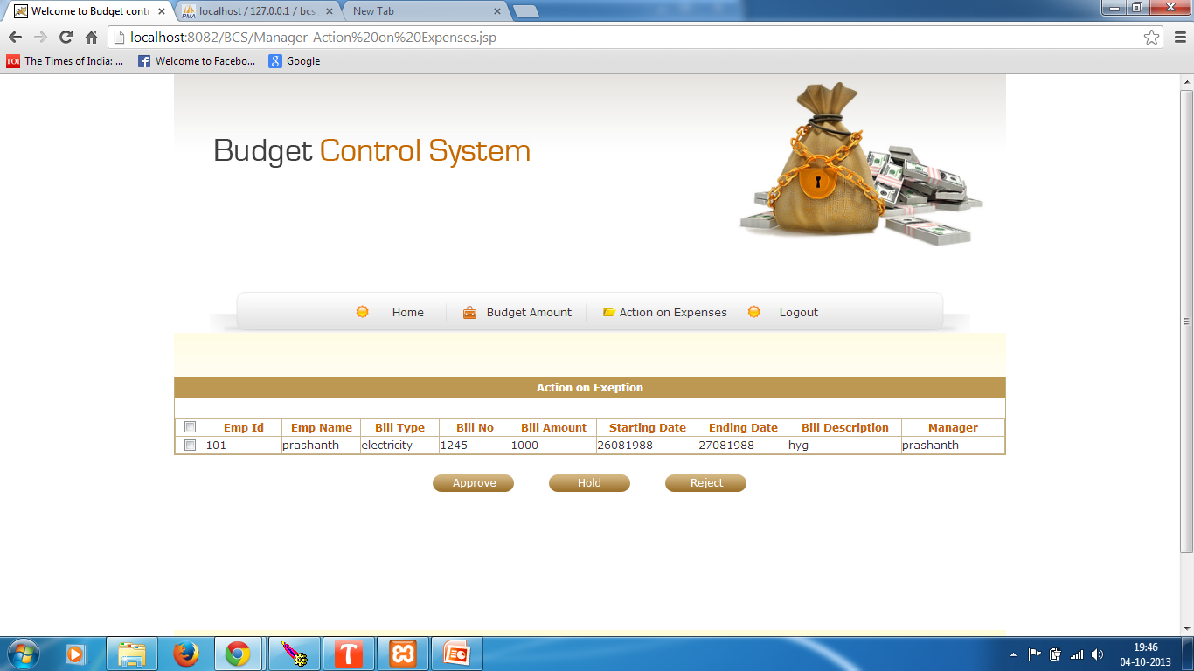
EXPENSES

Slide 40
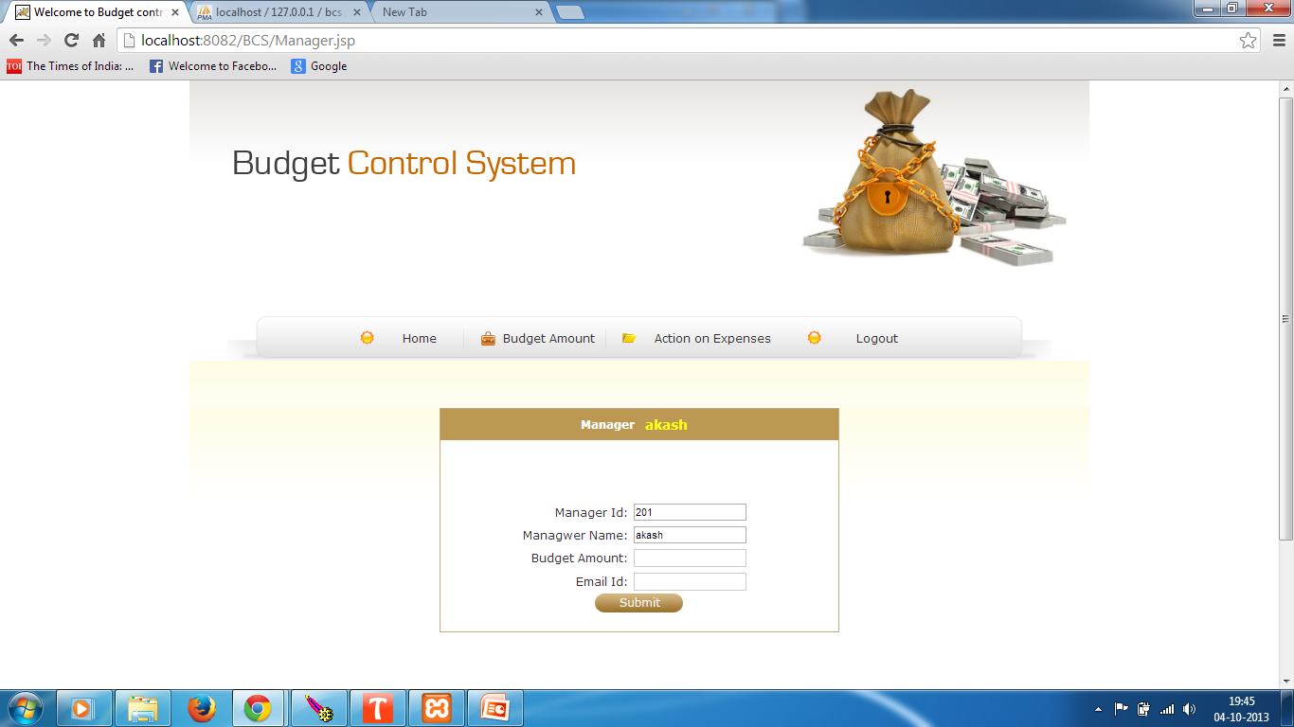
BUDGET

Slide 41
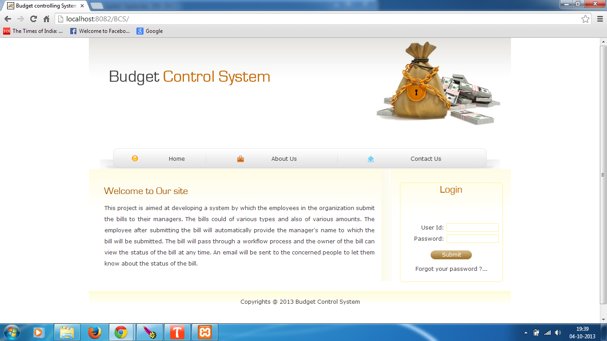
LOGIN

Slide 42
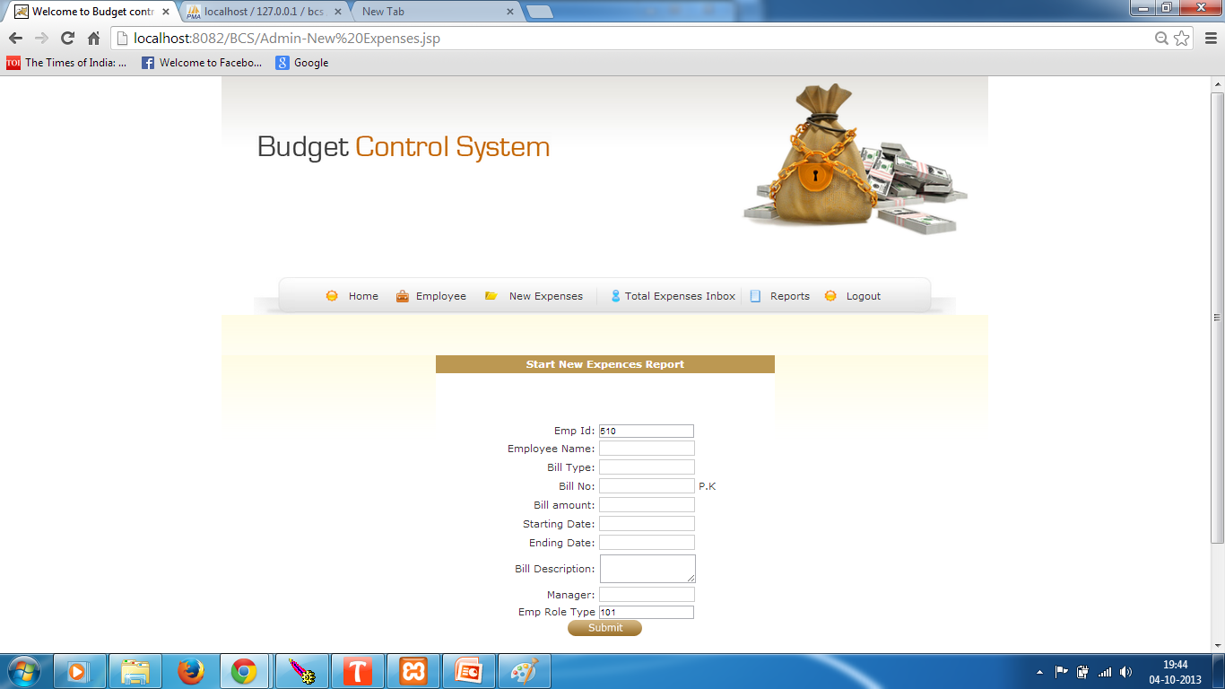
NEW EXPENSES

Slide 43
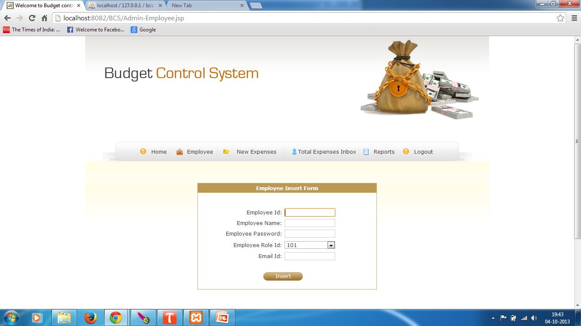
REGISTER

Slide 44
SAMPLE CODE

Slide 45
package com.mat.bcs;
import java.io.*;
import javax.servlet.*;
import javax.servlet.http.*;
public class AdminEmpInsertServlet extends HttpServlet {
public void doGet(HttpServletRequest request,HttpServletResponse response)throws IOException,ServletException
{}
public void doPost(HttpServletRequest request,HttpServletResponse response)throws IOException,ServletException
{
boolean flag=true;
String target="Admin-Employee.jsp?msg=unable to Insert";
try{
EmpInsertBean empInsertBean = new EmpInsertBean();
empInsertBean.setEmpid(Integer.parseInt(request.getParameter("empid")));
empInsertBean.setEmpname(request.getParameter("empname"));

Slide 46
empInsertBean.setEmppassword(request.getParameter("emppassword"));
empInsertBean.setEmproleid(Integer.parseInt(request.getParameter("emproleid")));
empInsertBean.setEmailid(request.getParameter("emailid"));
BcsFacade bcsFacade = new BcsFacade();
flag=bcsFacade.empInsertFacade(empInsertBean);
if (flag==true)
{target="Admin-Employee.jsp?msg=Successfully values are inserted";}
else
target="Admin-Employee.jsp?msg=Unable to insert the values";}//try
catch(Exception e)
{e.printStackTrace();}//catch
RequestDispatcher rd = request.getRequestDispatcher(target);
rd.forward(request, response);}//doPost
}//class

Slide 47
CONCLUSION
By using the budget controlling system, the user can monitor and control the income and expenditure. The flow of cash can be controlled which is very essential in any business environment.

Slide 48
THANK YOU

